Slide 1
HyperText Transfer Protocol
HTTP

Slide 2


Slide 3
Uniform Resource Locator
https://reddit.com/r/gifs
protocol: https
host: reddit.com
port: 80 or 443
path: /r/gifs

Slide 4
Hypertext Transfer Protocol
Hypertext
HTML or Hypertext Markup Language. The structure and content of a Web Page.
Protocol
A method of communication.

Slide 5
HTTP - Features
Client/Server
Request/Response
A “Stateless” Protocol

Slide 6
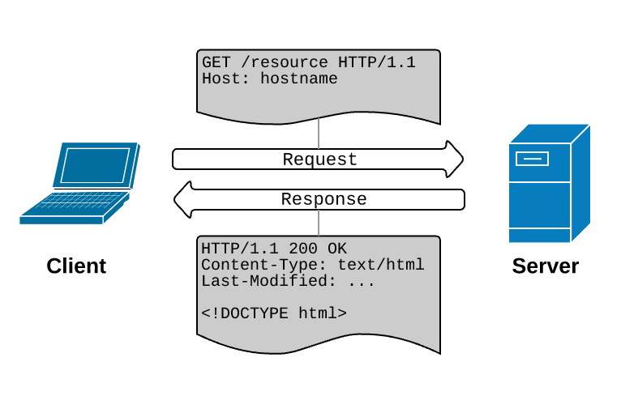

Slide 7
HTTP - Request/Response
Request
GET /r/gifs HTTP/1.1
Host: www.reddit.com
User-Agent: Mozilla/5.0
Body
Response
HTTP/1.1 200 OK
Date: Thu, 11 Apr 2011 20:49:02 GMT
Connection: keep-alive
Content-Type: text/html;charset=utf-8
<!DOCTYPE html>
<html lang=”en”>
<head>
<meta charset=”utf-8”> ...

Slide 8
HTTP - Request/Response
Request
Verb Path and Protocol
Headers: As
Key: Value Pairs
Optional Body
Response
Protocol Code Status
Headers: Which tell the browser what
to do.
Content-Type: This one is important!
Body

Slide 9
HTTP - Request
Verbs
GET
POST
PUT/PATCH
DELETE

Slide 10
HTTP - Request
Verbs
GET
POST
PUT/PATCH
DELETE
Server-side (CRUD) Actions
Retrieve (Read) a resource
Create a resource
Replace/Update part of a resource
Remove (Delete) a resource

Slide 11
Representational State Transfer
The mapping of HTTP Verbs to CRUD actions!
Read more about it at restapitutorial.com

Slide 12
HTTP - Status Codes
1xx - Informative
100 - Continue
101 - Switching
Protocols
102 - Processing
2xx - Success
200 - OK
201 - Created
202 - Accepted
...
3xx - Redirect
301 - Moved
Permanently
303 - See Other
304 - Not Modified
...
4xx - Client Error
400 - Bad Request
401 - Unauthorized
403 - Forbidden
404 - Not Found
5xx - Server Error
500 - Internal
Server Error
503 - Service
Unavailable

Slide 13
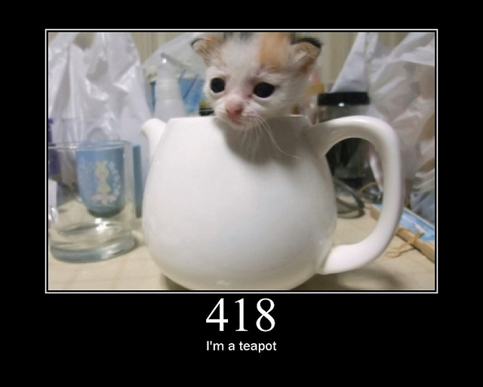

Slide 14
Thanks!
Any questions ?

Slide 15
Up Next...
Horizon Quiz
Afternoon Challenge

